Slide 1
Quantum Random Number Generation
Chaganti Kamaraja Siddhartha
EP20B012
Project Guide: Prof. Bijoy Krishna Das
EE4901:Mini-Project Jan-May 2024
Dept. of Electrical Engineering
IIT Madras
Outline
Overview
Motivation
Experimental setup
Noise characterisation
Post processing
Real time bit stream generation
Discussion
Applications

Slide 2


Experimental Setup
LASER
1550nm
50:50
Beam Splitter
TIA
Vacuum
Balanced
Photodetector
Computer
ADC + FPGA
Bit-stream
Extracted Noise
Signal (analog)

Slide 3


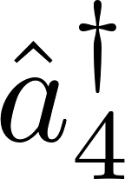


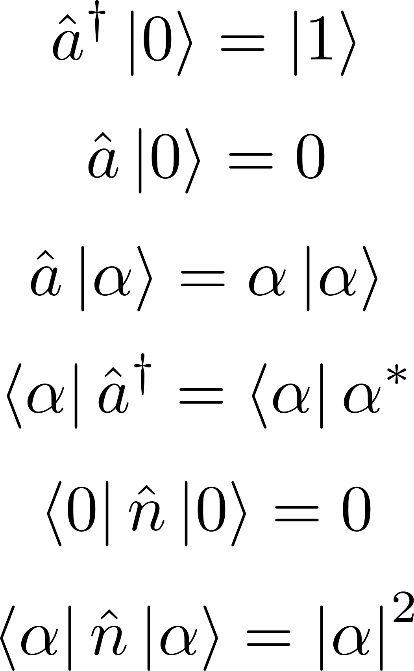
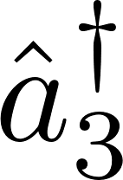
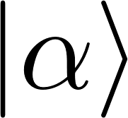
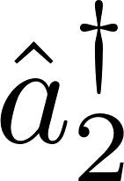

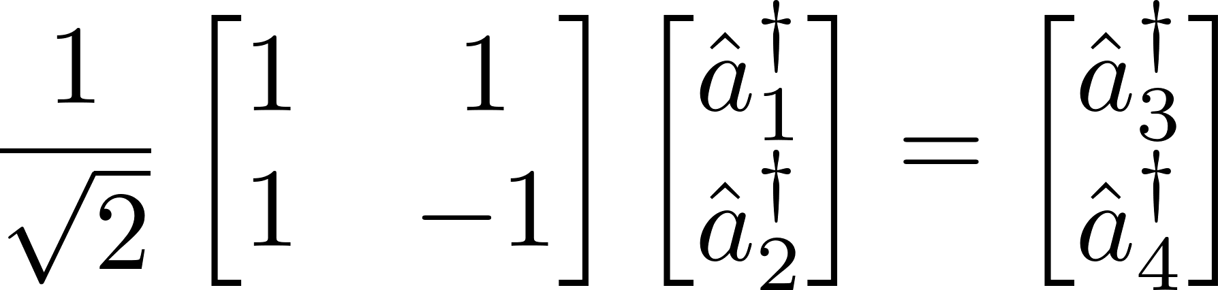
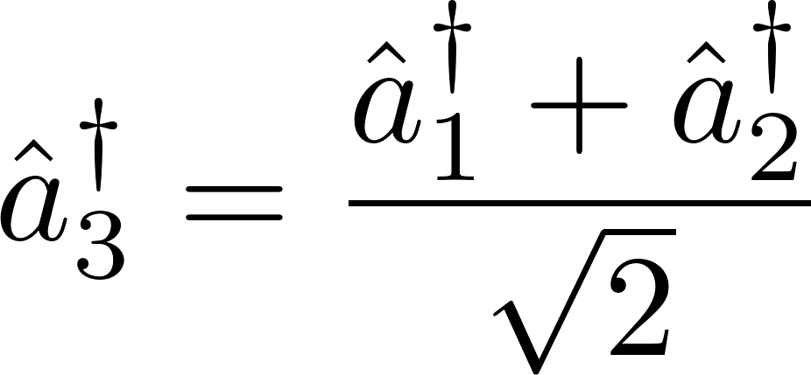
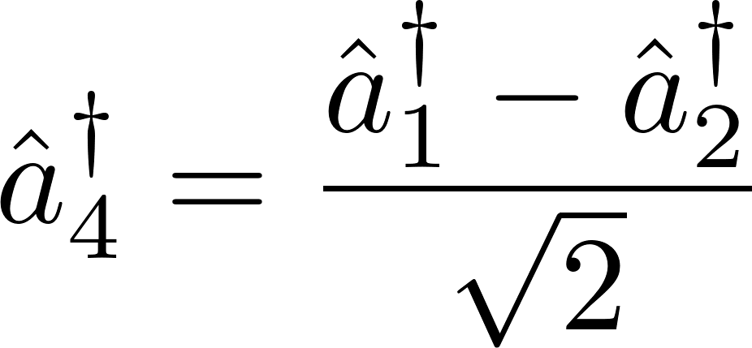
PD
Extracted Noise signal
Optical
outputs
SUB
1550 nm
Laser
PD
Optical
inputs
Beam splitter

Slide 4
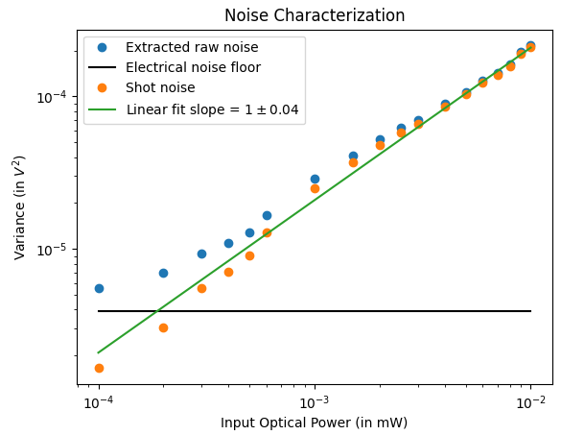
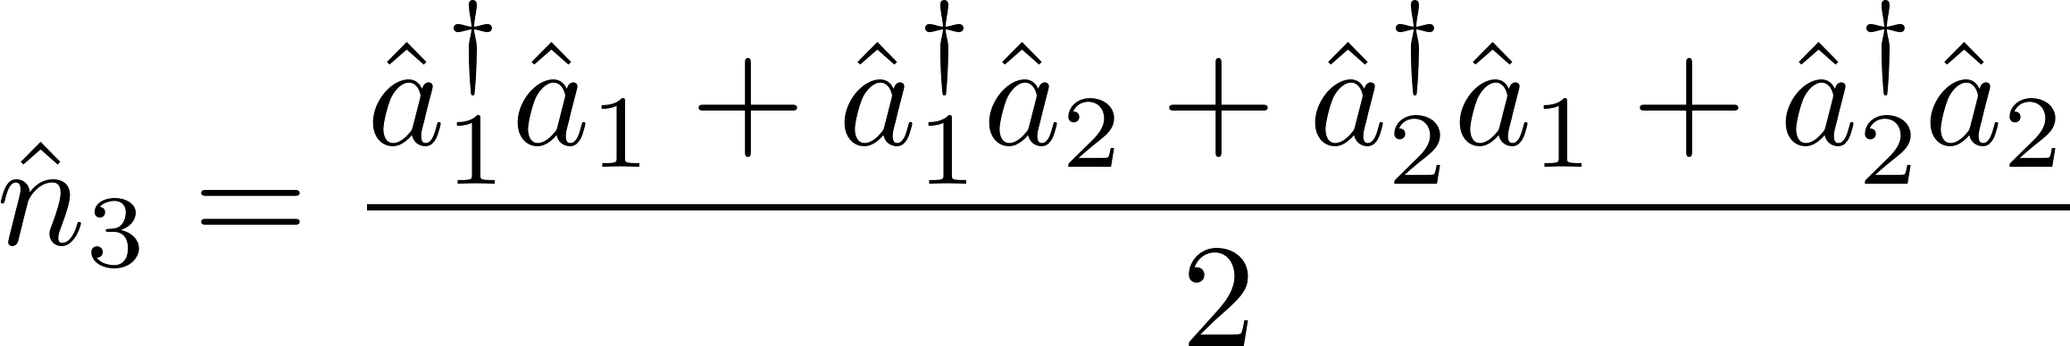
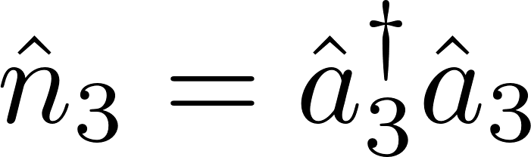
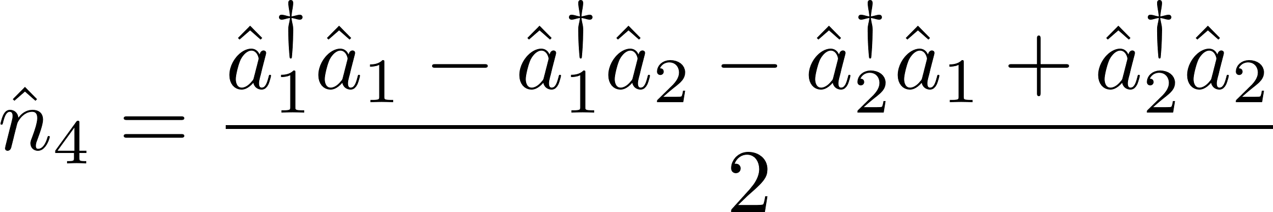
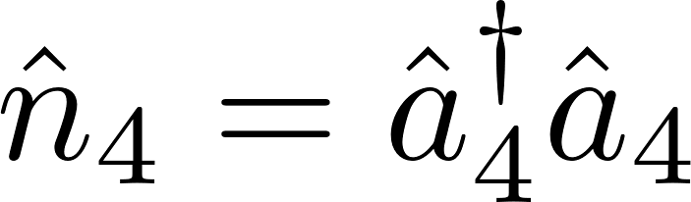
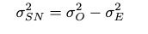
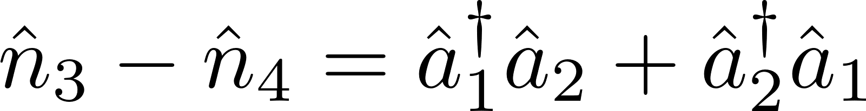



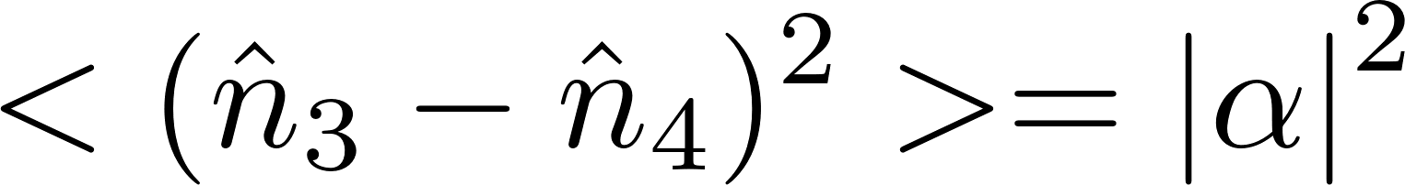
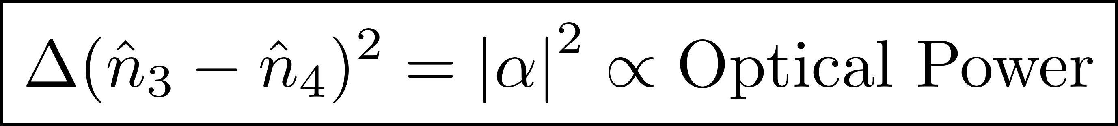

Slide 5
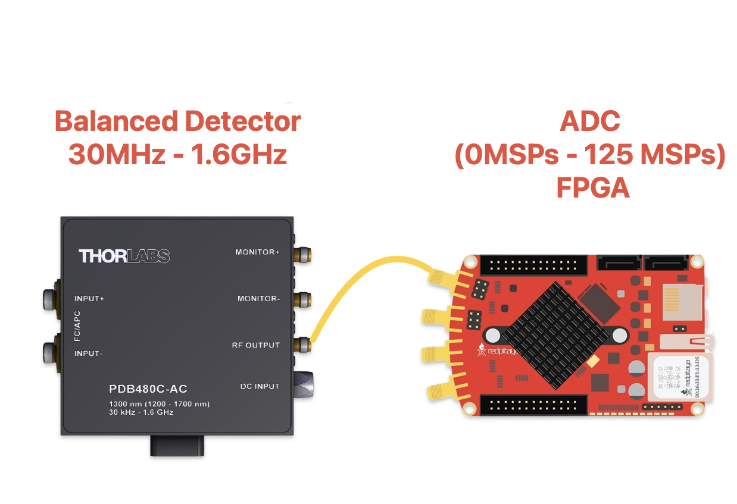
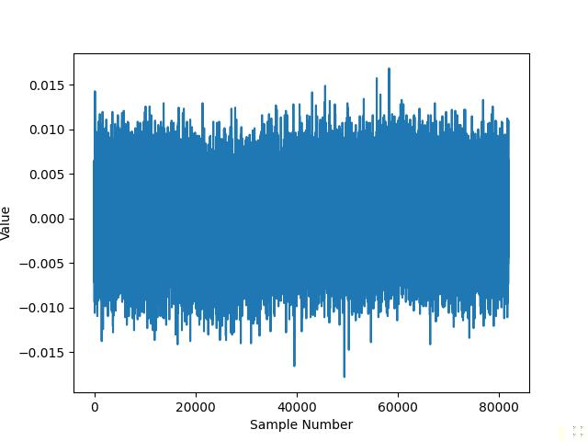
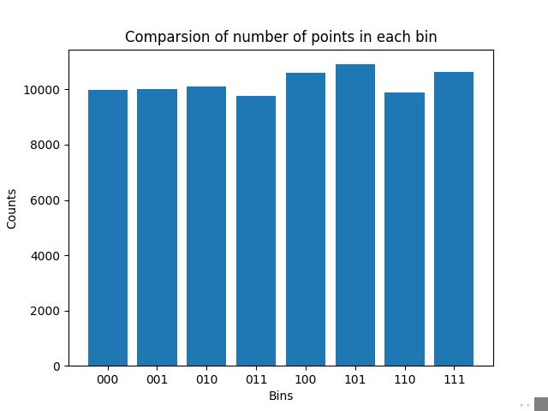
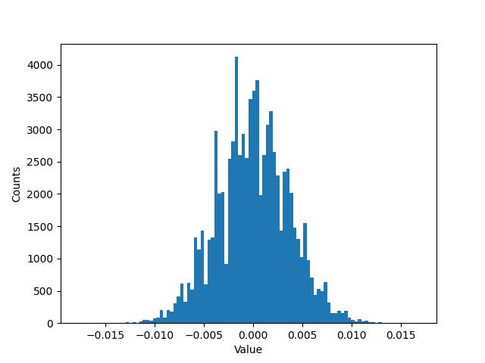
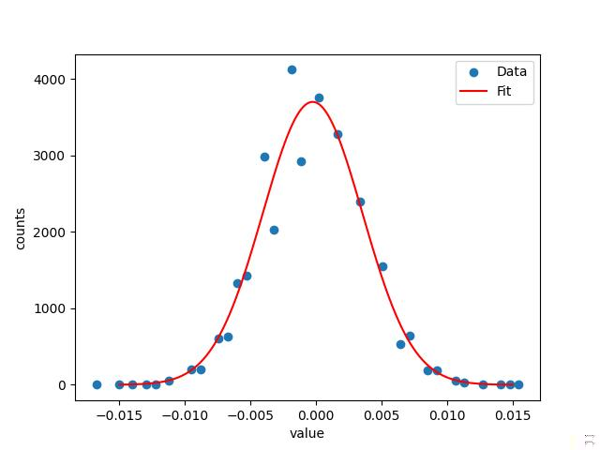
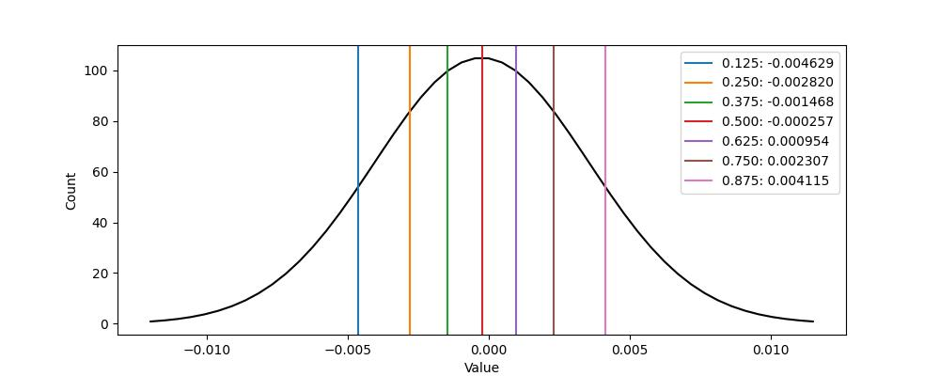
Post-processing
000
001
010
011
100
101
110
111

Slide 6
Experimental Setup with DSO
LASER
1550nm
50:50
Beam Splitter
TIA
Vacuum
Balanced
Photodetector
Computer
DSO
Samples
Extracted Noise
Signal (analog)

Slide 7
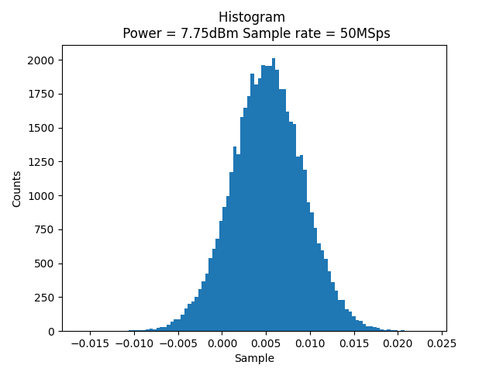
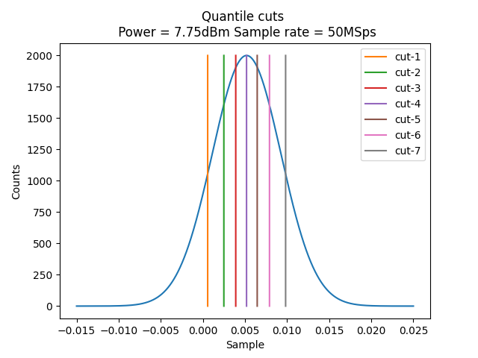
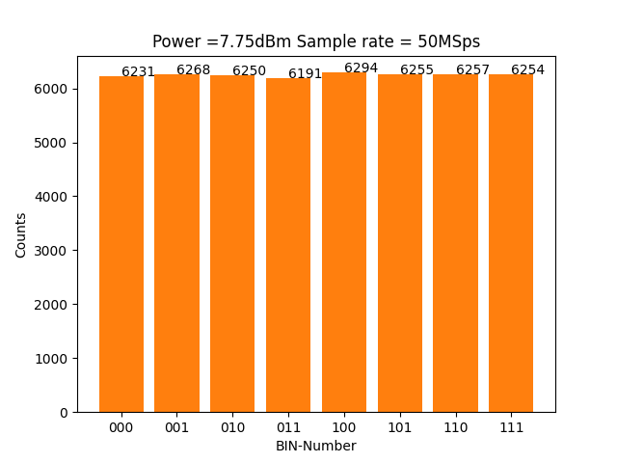
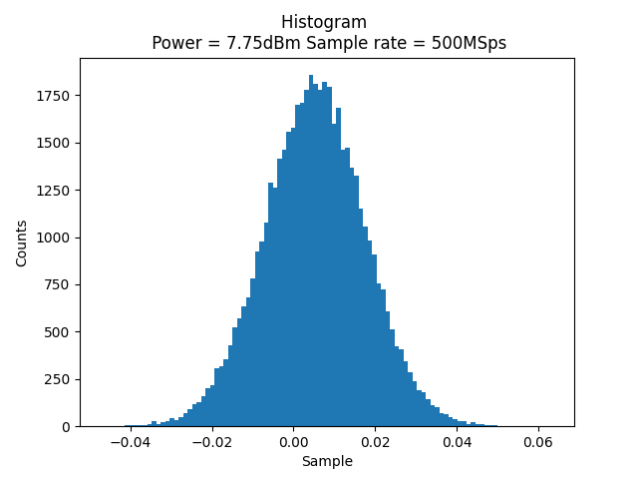
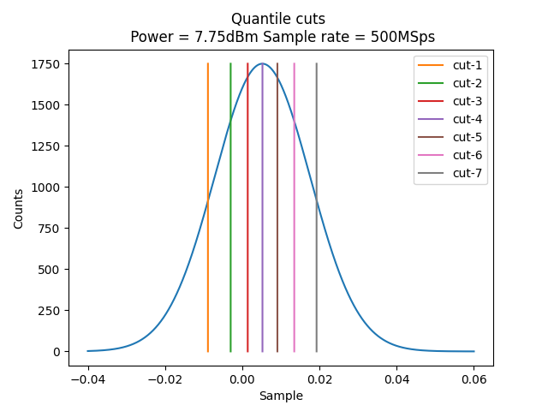
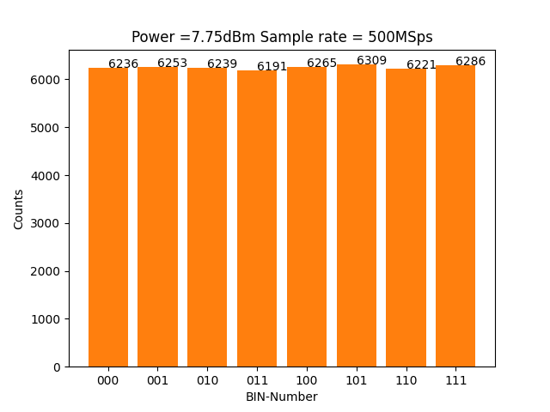
Post processing with DSO
150,000 bits are tested using NIST test suite
50 MSPs
Passed 12/15 tests
500 MSPs
Passed 11/15 tests

Slide 8
Post processing with DSO
150,000 bits are tested using NIST test suite
50 MSPs
100 Megabits are needed to test NIST test suite
Passed 12/15 tests
500 MSPs
Passed 11/15 tests

Slide 9
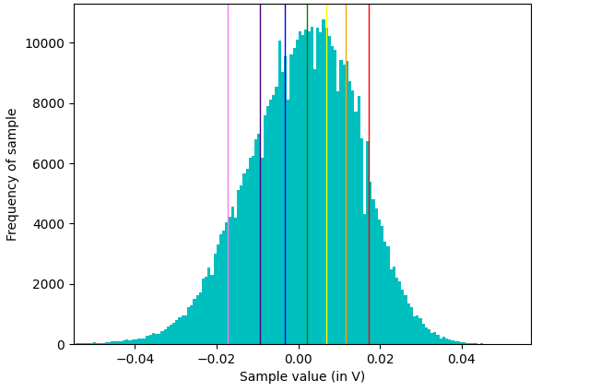
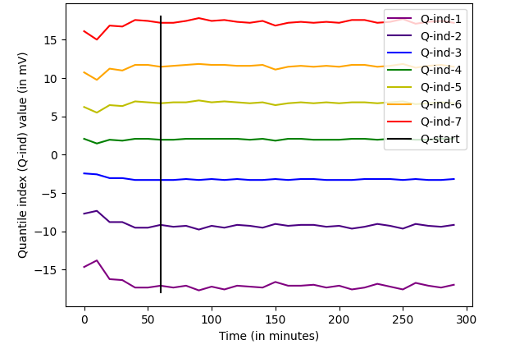
Bit-stream generation with FPGA
Normal distribution
Variation of quantiles w.r.t time
1.6 Lakh samples (chunk) acquired at 31.25 MSps
30 chunks for every 10 min.
Repeated for 5 hours
Data of starting 1 hour is ignored in quantiles calculation.

Slide 10
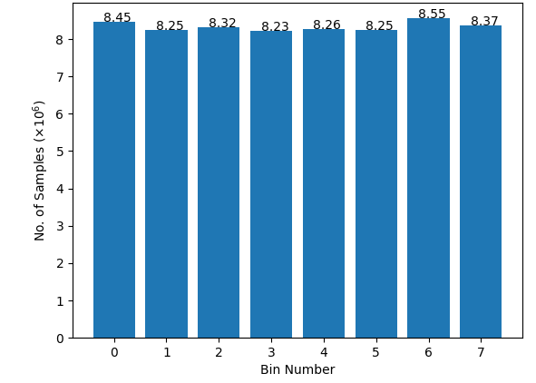
Bit-stream generation
Bin proportion
200 Megabits are generated
Avg. Speed of 20 Kbps
Bits arrive at different time intervals

Slide 11
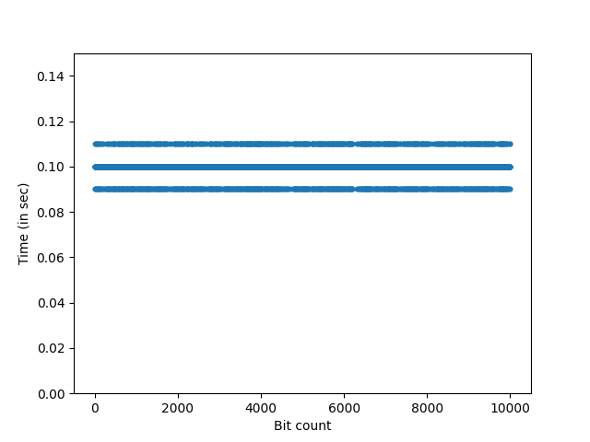
Real time Bit-streaming
Bits should arrive at equal intervals for QKD applications
10,000 bits are received at a time interval of 0.1 $±$ 0.01 s
10,000 bits are received at a time interval of 0.1 ± 0.01 s
Speed = 10 bits/s
Time difference between two consecutive bits

Slide 12
Future Work
PIC is used in place of optical fibre
Improve speed of real time bit stream
Quality check of Random bits using NIST test suite

Slide 13
Overview
Why Quantum is needed to generate random numbers?
Motivation
What is Quantum in Quantum Random Number Generator?
Experimental setup
Noise characterisation
How is Quantum noise used to generate random numbers?
Post processing
Real time bit stream generation
Discussion
Where is Quantum Random Number generator used?
Applications

Slide 14
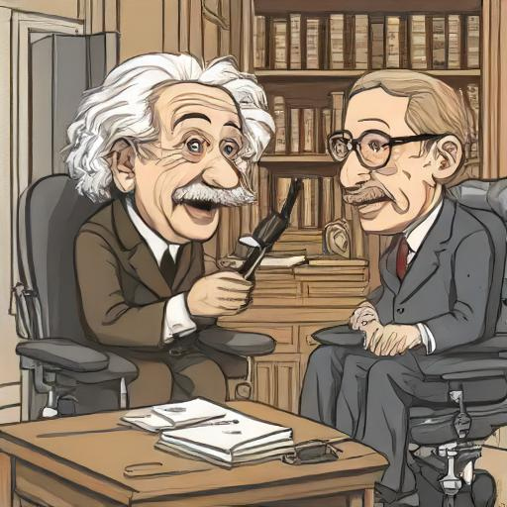
Motivation
Not only does god play dice, but… he sometimes throws them where they cannot be seen.
God doesn’t play dice with the universe
Quantum theory is probabilistic!!
AI generated cartoon of Albert Einstein and Stephen Hawking

Slide 15
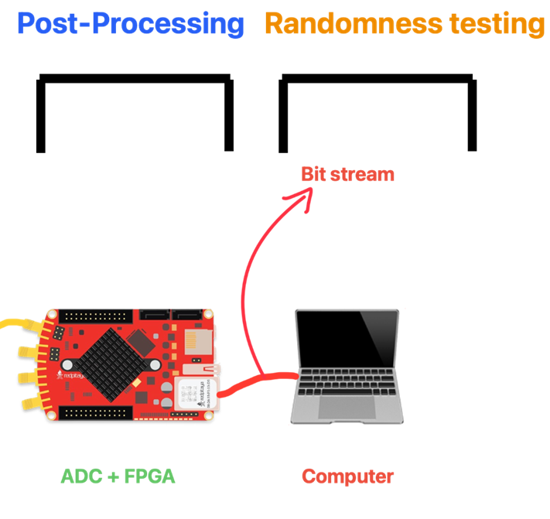
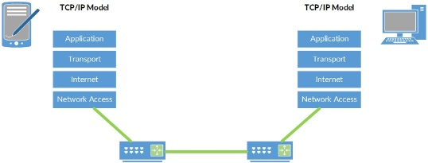
Post processing Real time
Red pitaya has a ram of 512 MB.
Clock speed of DDR3 is 557 MHz .
Around Half million samples are used to determine the quantile cuts.
150 million bits are transferred to computer using TCP/IP protocol.
7Kb/s
TCP/IP protocol is used to send bit stream real time

Slide 16
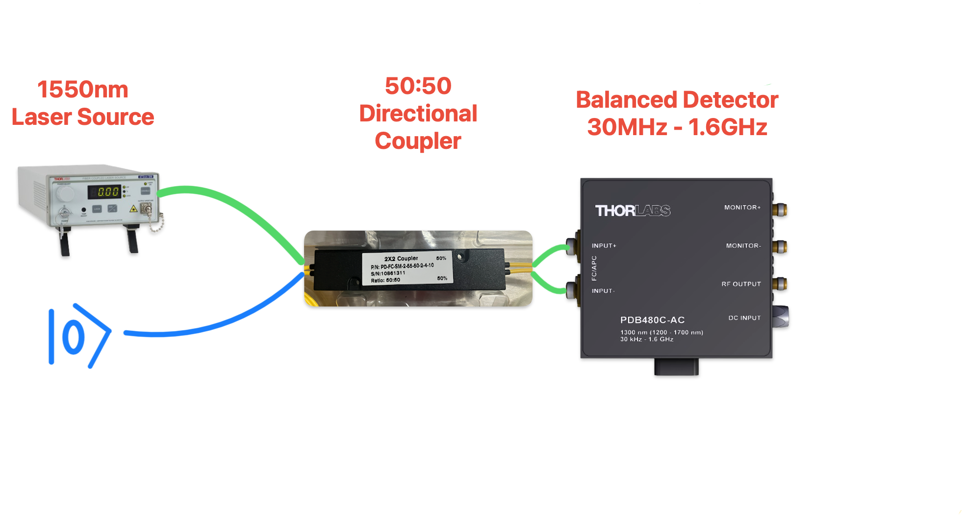
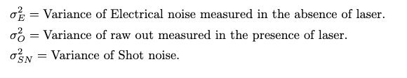
Noise Characterization

Slide 17
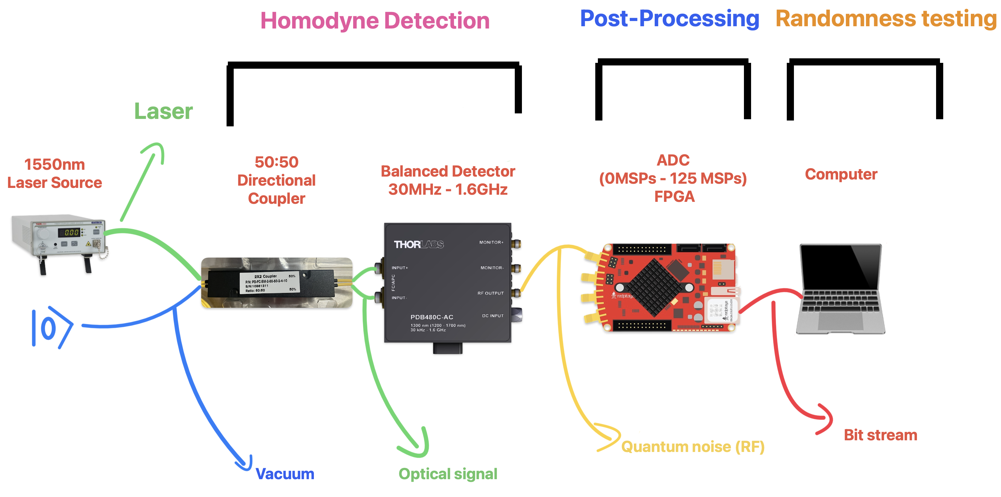
Experimental Setup

Slide 18
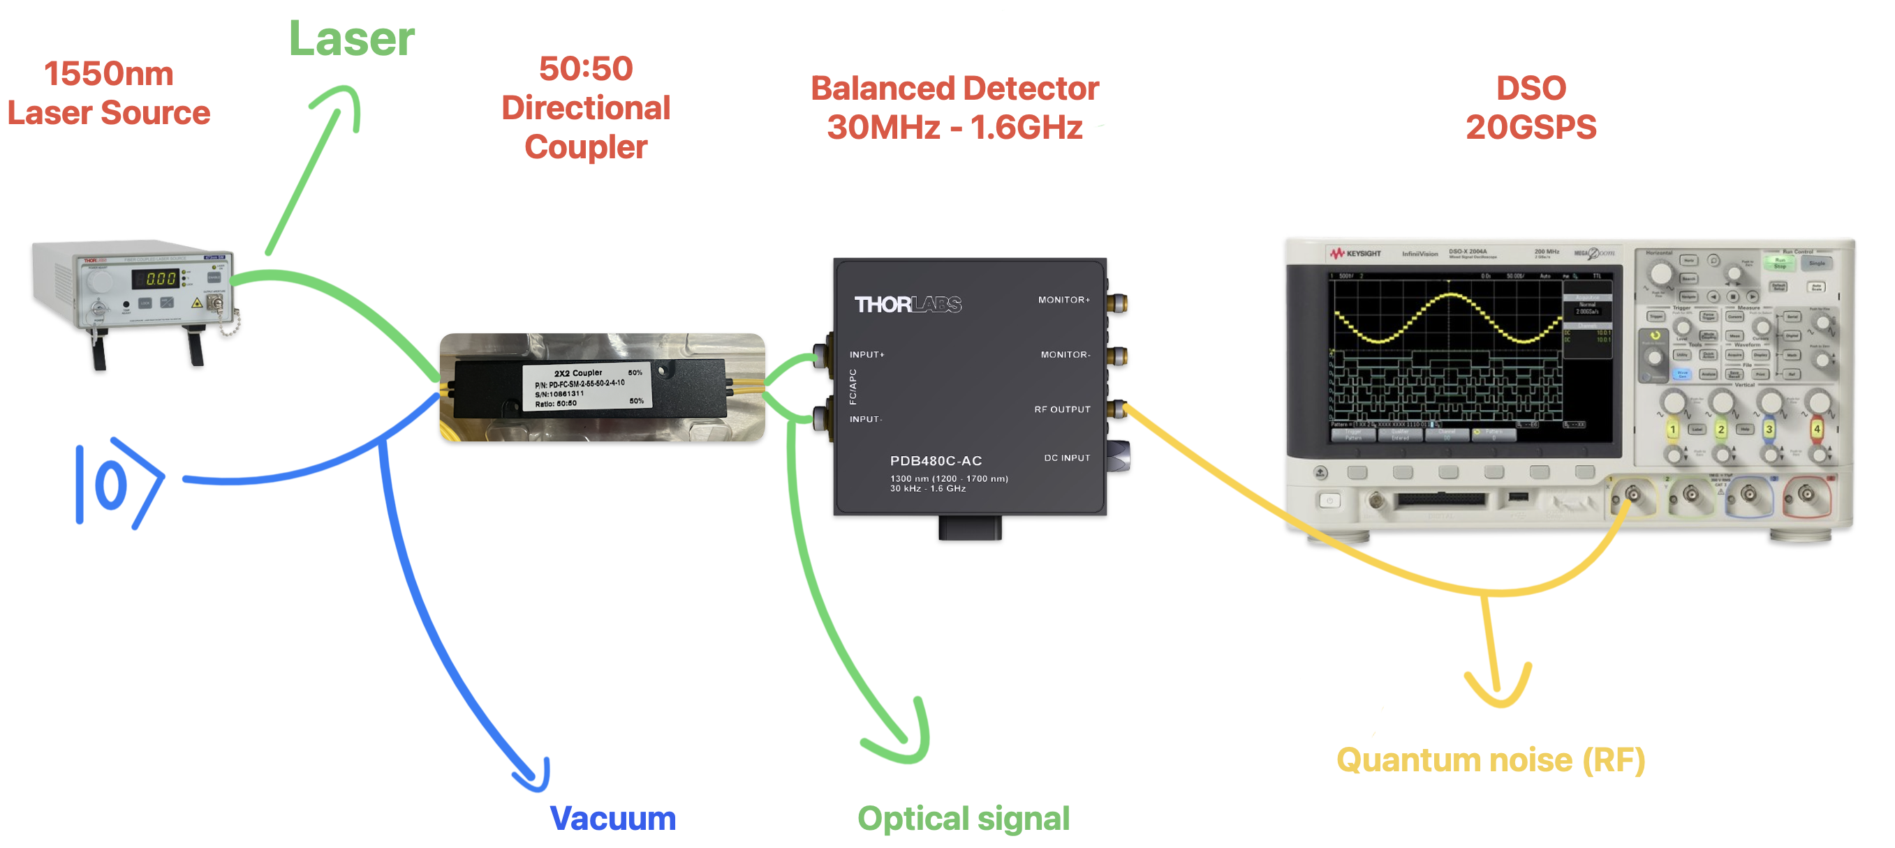
DSO Experimental Setup

Slide 19
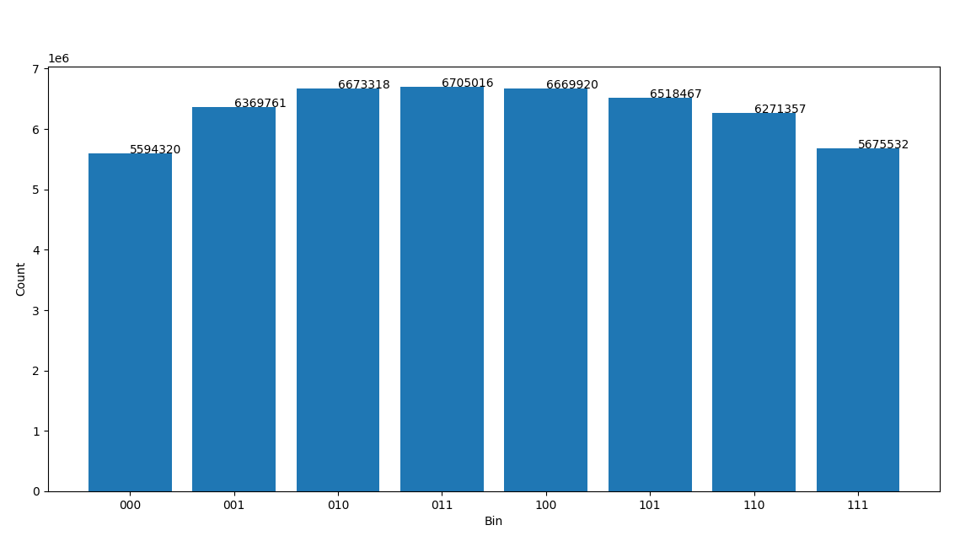
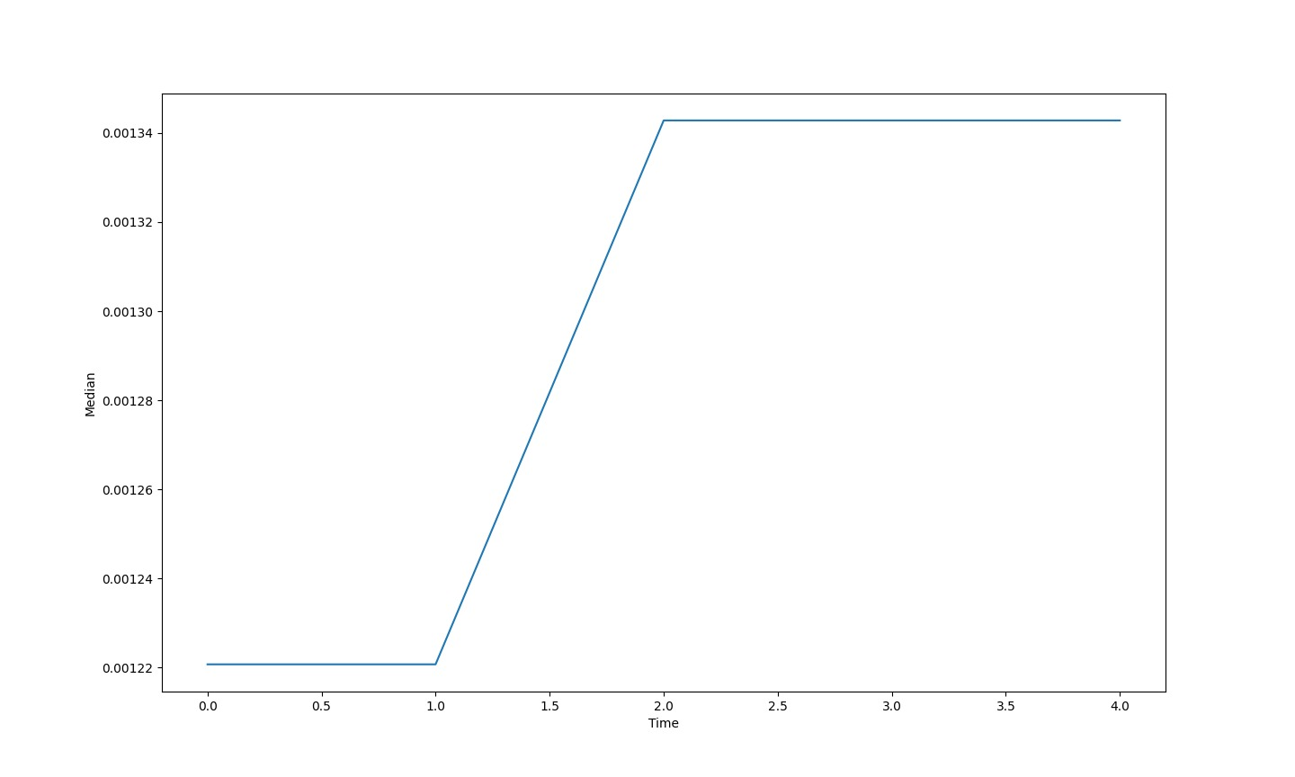
Discussion
Quantization of samples into bins
Variation of median of samples as time progress

Slide 20

Applications
Quantum Key Distribution

